Slide 1


Logo Detection and Recognition

Slide 2


Computer Vision - 21TGMT
Logo Detection and Recognition
Group 5:
21127090 - Vo Nguyen Hoang Kim
21127115 - Tran Thanh Ngan
21127118 - Lam Thanh Ngoc

Slide 3
OUTLINE
01
Introduction
02
Logo Detection using YOLO
03
Advantages & Disadvantages
04
Demo
05
Results & Conclusion

Slide 4


01
INTRODUCTION

Slide 5

What is Logo Detection and Recognition ?
Logo detection focuses on detecting whether a particular logo is present in an image or video, often involving localization techniques such as bounding box detection. On the other hand, logo recognition goes further by not only detecting the presence of logos but also accurately classifying and identifying them, distinguishing between different types or variants of logos belonging to various brands.

Slide 6

SIFT Descriptor
Feature Pyramid Networks (FPN)
SURF Descriptor
Faster R-CNN
HoG Descriptor
METHODS
YOLO
Convolutional Neural Network (CNN)
Region Proposal Network (RPN)

Slide 7
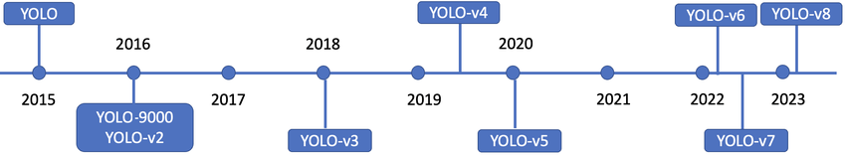
YOLO (You Only Look Once)
YOLO is a popular object detection model known for its fast speed and high accuracy. This model was first introduced by Joseph Redmon and his colleagues in 2016. Since then, there have been several versions of YOLO, with one of the latest versions being YOLO v8.
YOLO proposes the use of an end-to-end neural network to simultaneously predict bounding boxes and object probabilities. It differs from the approach of previous object detection algorithms, which typically reused classifiers to perform detection.

Slide 8
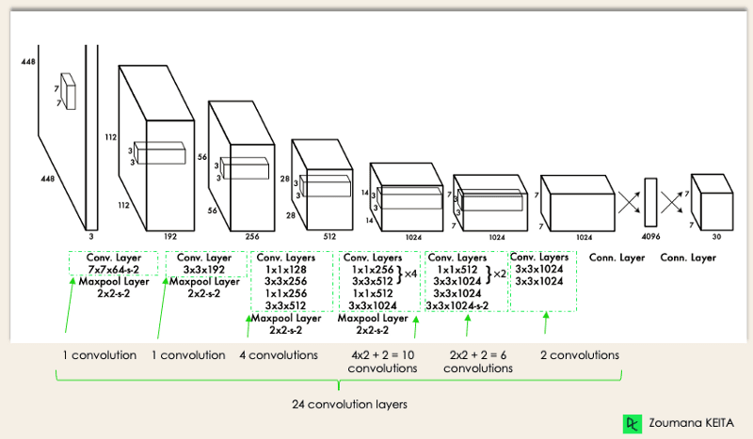
YOLO Architecture

Slide 9
02
LOGO DETECTION USING YOLO

Slide 10
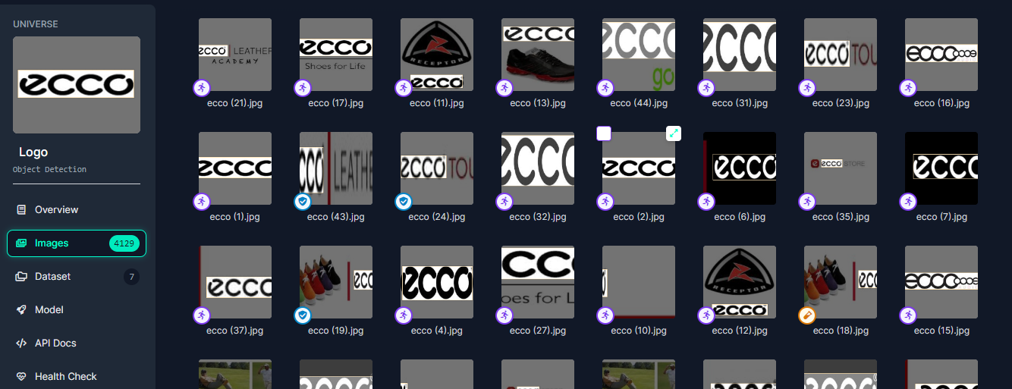
Dataset
( from roboflow )

Slide 11
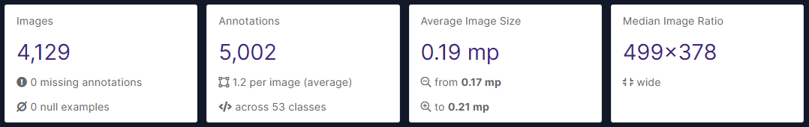
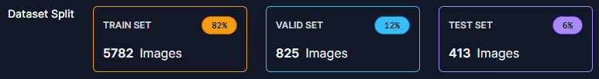
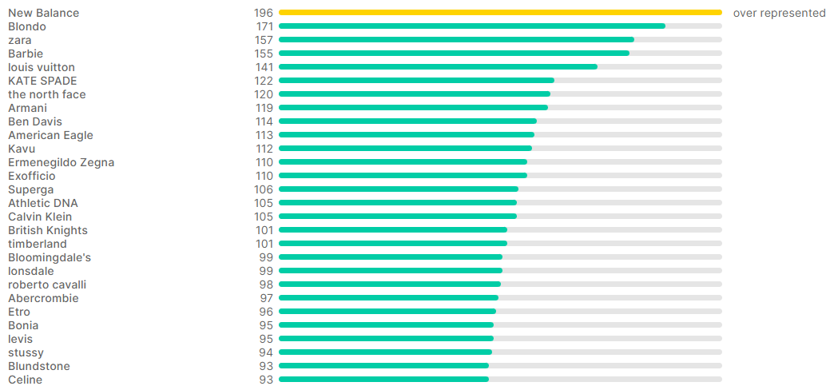
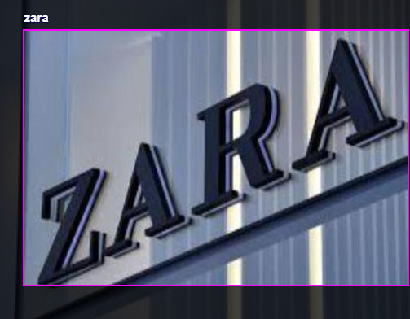
DATASET
OVERVIEW

Slide 12
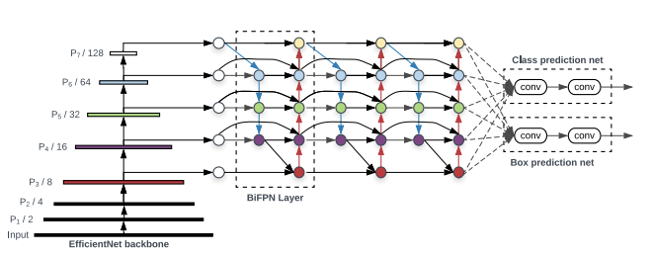
YOLO v5
YOLO v5 was introduced in 2020 by the same team that developed the original YOLO algorithm as an open-source project and maintained by Ultralytics.
EfficientDet Architecture
Unlike YOLO, YOLO v5 utilizes a more complex architecture called EfficientDet, based on the EfficientNet network architecture. The use of a more complex architecture in YOLO v5 allows it to achieve higher accuracy and better generalization capabilities for a wider range of objects.

Slide 13
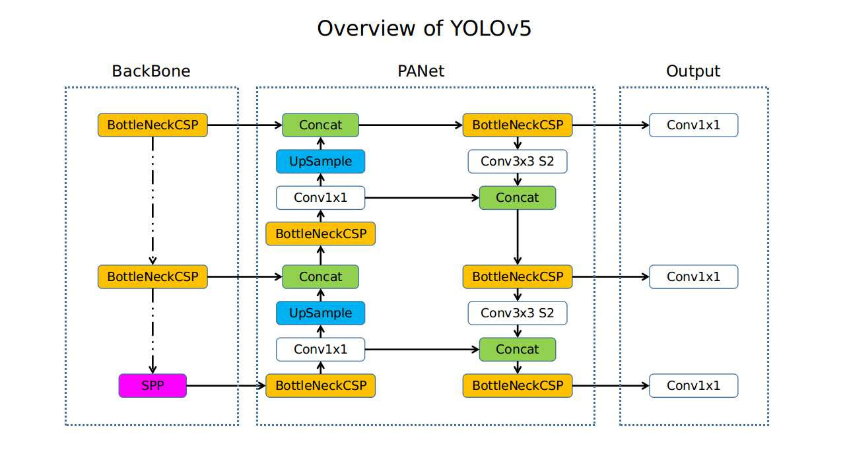

Slide 14
03
ADVANTAGES & DISADVANTAGES

Slide 15


Advantages
High Accuracy
Fast Inference Speed
Ease of Use
Robustness
YOLOv5 typically achieves high accuracy in object detection tasks due to its advanced architecture and training methodologies.
It is known for its fast inference speed, making it suitable for real-time applications where quick responses are crucial.
YOLOv5 is relatively easy to use and implement, with pre-trained models and straightforward training procedures available.
It demonstrates resilience to variations in object size, orientation, and cluttered backgrounds, making it adaptable to diverse real-world scenarios.

Slide 16

Disadvantages
Computational Resources
Generalization Capability
Training Data Requirement
Model Size
YOLOv5 may require more computational resources compared to previous versions of YOLO or some other object detection models, especially during training.
While YOLOv5 demonstrates flexibility with variations of objects, it may not perform as effectively as specialized models for specific tasks such as detecting small or occluded objects.
YOLOv5 often requires a large amount of training data to achieve optimal performance, and collecting and preparing this data can require significant effort.
YOLOv5 models typically have larger file sizes compared to some other models, which can be a limitation when deploying in resource-constrained systems.

Slide 17
04
DEMO TIME !
CLICK HERE FOR DEMO

Slide 18
05
RESULTS & CONCLUSION

Slide 19

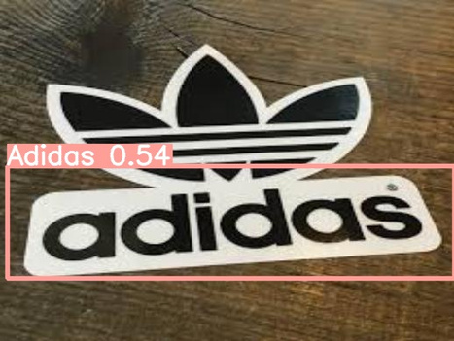
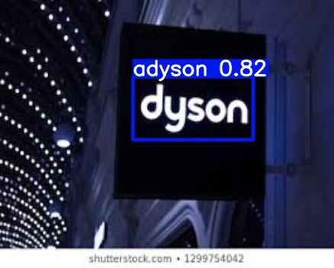
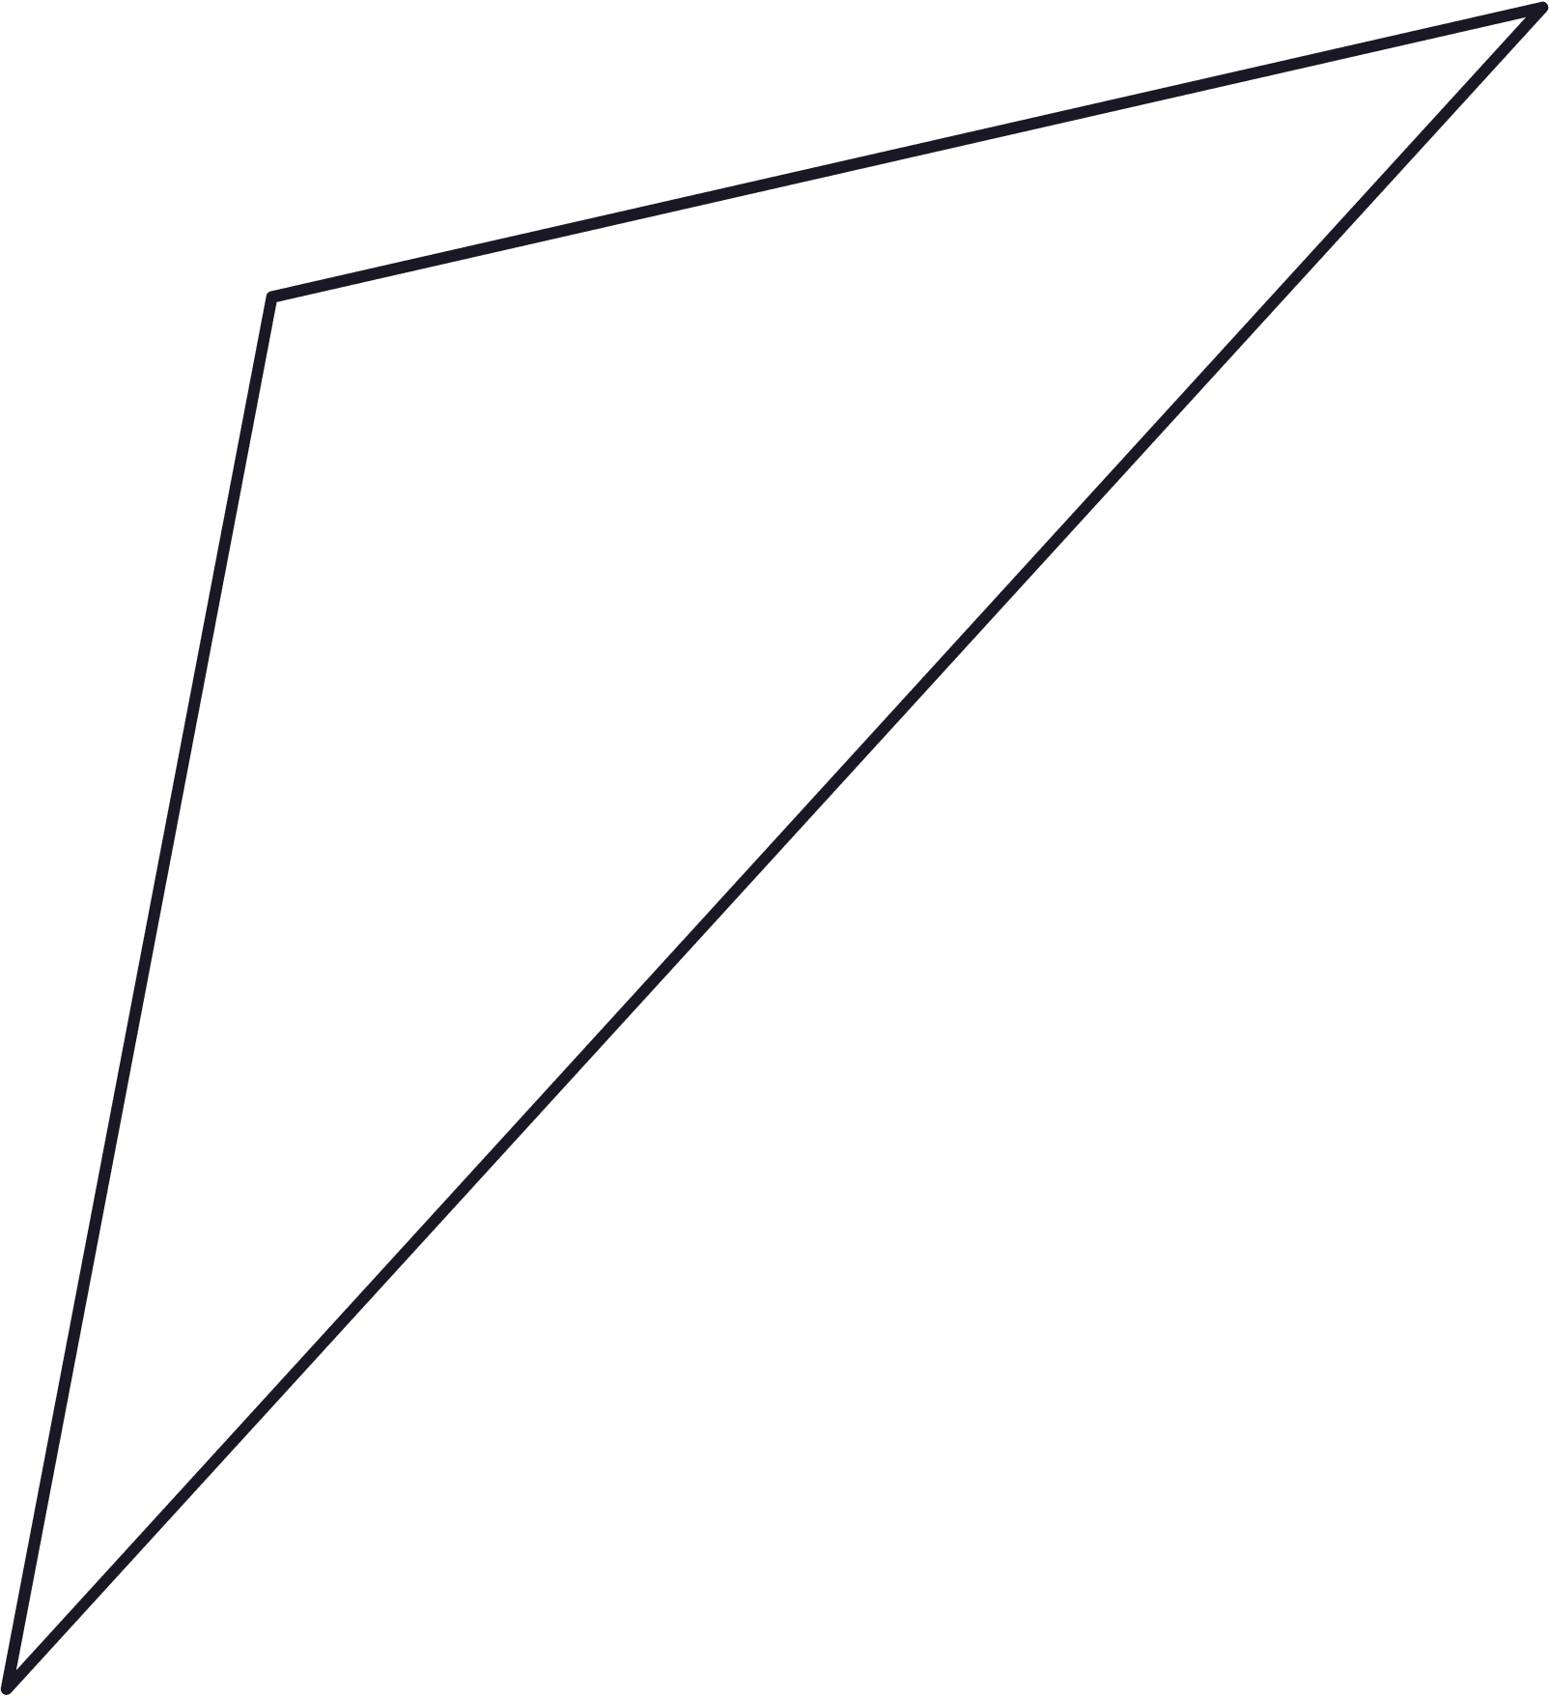
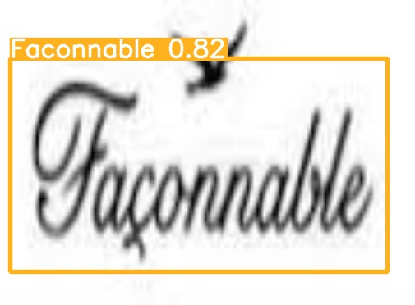
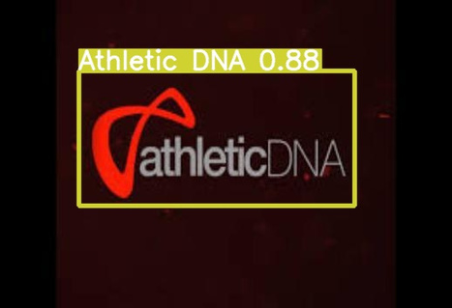
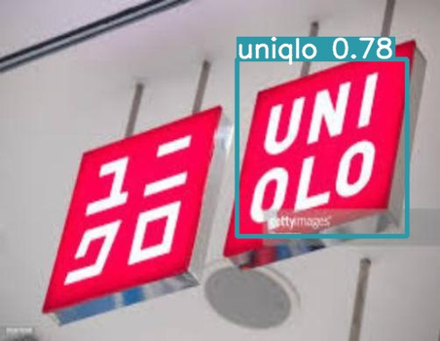
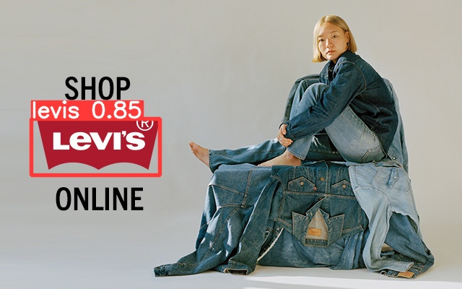
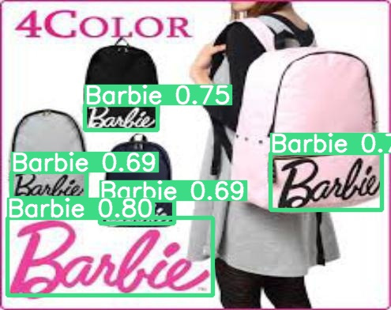
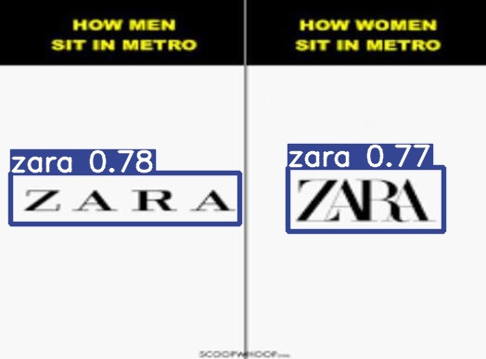
RESULTS

Slide 20

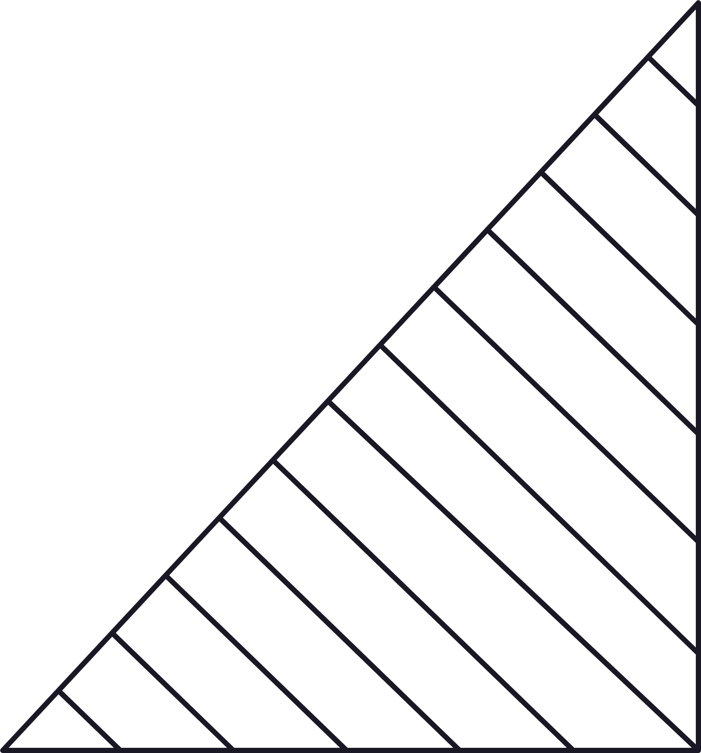
Promising solution for various real-world applications.
YOLOv5 boasts high accuracy, fast speed, and good stability, making it an attractive choice for logo detection tasks in real-world applications across various industries.
CONCLUSION
Despite its computational requirements and potential limitations in generalization, YOLOv5 showcases resilience to variations in logo size, orientation, and background clutter, underscoring its adaptability to diverse real-world scenarios.

Slide 21
THANKS FOR LISTENING !

